Slide 1

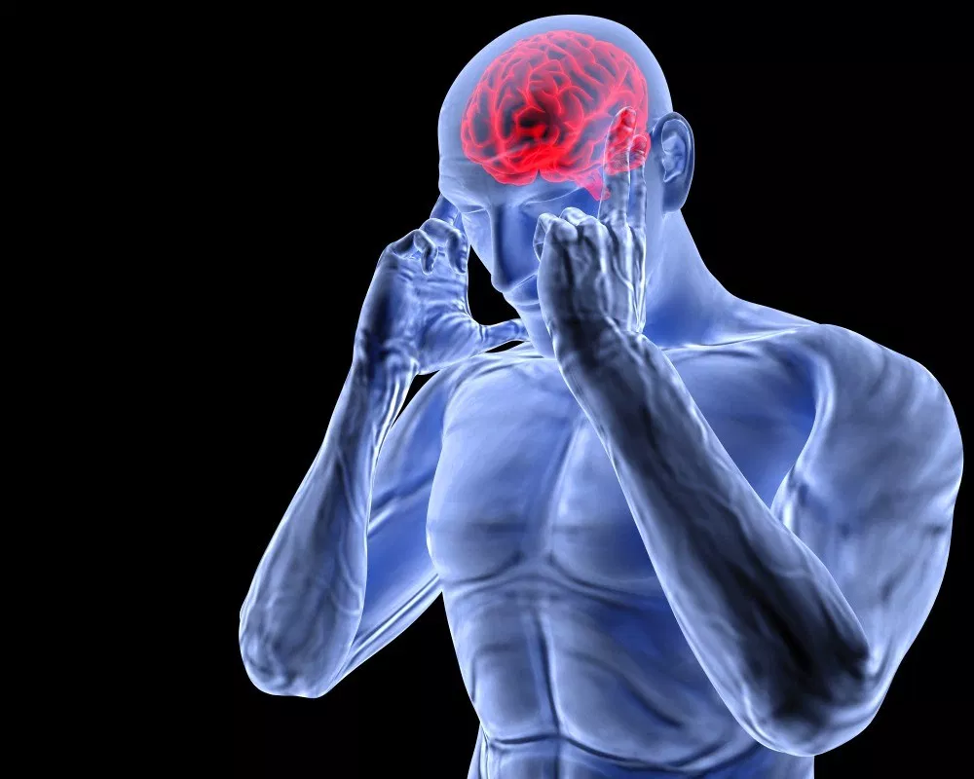
Stress
ORGB1500 - Organizational Behaviour for Media and IT - Ed Beerwart

Slide 2

Stress
Content
Two Types of Stress
Stress
Eustress
Distress
General Adaptation Syndrome (GAS)
Alarm stage
Adaptation stage
Exhaustion stage
Fight/Flight
Three Categories of Stress
Acute
Episodic
Chronic
Major Causes of Stress
Strategies to Manage Stress

Slide 3
Two Types of Stress

Slide 4
Stress
R
U
“
A state of physiological or psychological response to internal or external stressors.
”
VandenBos, G. R. (Ed.). (2007). APA Dictionary of Psychology. Washington, DC, US: American Psychological Association.

Slide 5
Stress
R
U
“
Stress involves changes affecting nearly every system of the body, influencing how people feel and behave.
For example, it may be manifested by palpitations, sweating, dry mouth, shortness of breath, fidgeting, faster speech, augmentation of negative emotions (if already being experienced), and longer duration of stress fatigue.
”
VandenBos, G. R. (Ed.). (2007). APA Dictionary of Psychology. Washington, DC, US: American Psychological Association.

Slide 6
Stress
R
U
“
Severe stress is manifested by the “General Adaptation Syndrome”.
By causing these mind-body changes, stress contributes directly to psychological and physiological disorder and disease and affects mental and physical health, reducing the quality of life.
”
VandenBos, G. R. (Ed.). (2007). APA Dictionary of Psychology. Washington, DC, US: American Psychological Association.

Slide 7
Eustress
R
U
“
A type of stress that results from being overwhelmed by multiple enjoyable or worthwhile tasks.
It has a beneficial effect by generating a sense of fulfillment or achievement.
”
VandenBos, G. R. (Ed.). (2007). APA Dictionary of Psychology. Washington, DC, US: American Psychological Association.

Slide 8
Distress
R
U
“
A negative emotional state in which the specific quality of the emotion is unspecified or unidentifiable.
For example, “stranger anxiety” in infants is more properly designated “stranger distress” because the infant’s negative behavior, typically crying, allows no more specific identification of the emotion.
”
VandenBos, G. R. (Ed.). (2007). APA Dictionary of Psychology. Washington, DC, US: American Psychological Association.

Slide 9

Eustress / Distress
Ap
An
What event in our own lives might trigger eustress?
What event in our own lives might trigger distress?

Slide 10
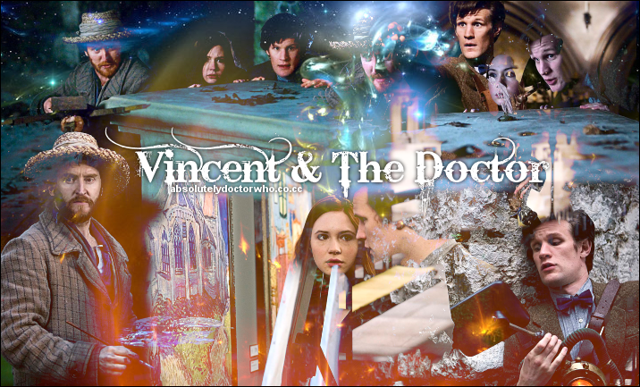

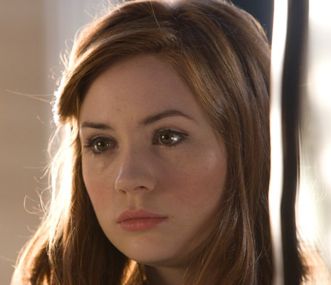
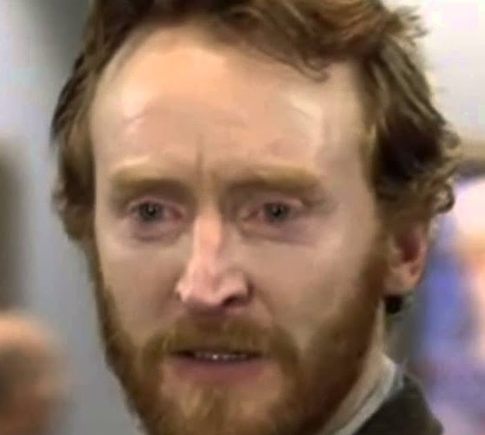
Stress example
Ap
Doctor Who
Season 05 Episode 10
“Vincent and the Doctor”
(46 mins)
The Doctor and Amy travel back in time to meet Vincent Van Gogh and face an invisible monster that only the painter can see.
The
Doctor
Amy
Pond
Vincent Van Gogh

Slide 11
Eustress / Distress
Ap
An
Which event(s) triggered eustress in the characters?
Which event(s) triggered distress in the characters?
Was there anything similar about the events/emotions ?
The
Doctor
Amy
Pond
Vincent Van Gogh

Slide 12




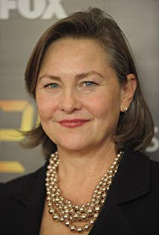

Stress example
Ap
Black Mirror
Season 3 Episode 1
“Nosedive”
(63 mins)
A woman desperate to boost her social media score hits the jackpot when she's invited to a swanky wedding, but the trip doesn't go as planned.
Lacie
Pound
Ryan
Pound
Naomi
Blestow
Susan
Prisoner

Slide 13
Eustress / Distress
Ap
An
Which event(s) triggered eustress in the character?
Which event(s) triggered distress in the character?
Was there anything similar about the events/emotions ?
Lacie
Pound

Slide 14
General Adaptation Syndrome

Slide 15
General Adaptation Syndrome
R
U
“
The physiological consequences of severe stress. The syndrome has three stages: alarm, resistance, and exhaustion.
”
VandenBos, G. R. (Ed.). (2007). APA Dictionary of Psychology. Washington, DC, US: American Psychological Association.

Slide 16
General Adaptation Syndrome – Alarm Stage
R
U
“
The first stage, the alarm reaction (or alarm stage), comprises two sub-stages:
the shock phase, marked by a decrease in body temperature, blood pressure, and muscle tone and loss of fluid from body tissues;
and the countershock phase, during which the sympathetic nervous system is aroused and there is an increase in adrenocortical hormones, triggering a defensive reaction, such as the “fight-flight reaction”.
”
VandenBos, G. R. (Ed.). (2007). APA Dictionary of Psychology. Washington, DC, US: American Psychological Association.

Slide 17
General Adaptation Syndrome – Adaptation Stage
R
U
“
The resistance stage (or adaptation stage) consists of stabilization at the increased physiological levels.
High blood pressure can develop into hypertension, with risk of cardiovascular disturbance.
Resources may be depleted, and permanent organ changes produced.
”
VandenBos, G. R. (Ed.). (2007). APA Dictionary of Psychology. Washington, DC, US: American Psychological Association.

Slide 18
General Adaptation Syndrome – Exhaustion Stage
R
U
“
The exhaustion stage is characterized by breaking down of acquired adaptations to a prolonged stressful situation;
it is evidenced by sleep disturbances, irritability, sever loss of concentration, restlessness, trembling that disturbs motor coordination, fatigue, jumpiness, low startle threshold, vulnerability to anxiety attacks, depressed mood, and crying spells.
”
VandenBos, G. R. (Ed.). (2007). APA Dictionary of Psychology. Washington, DC, US: American Psychological Association.

Slide 19
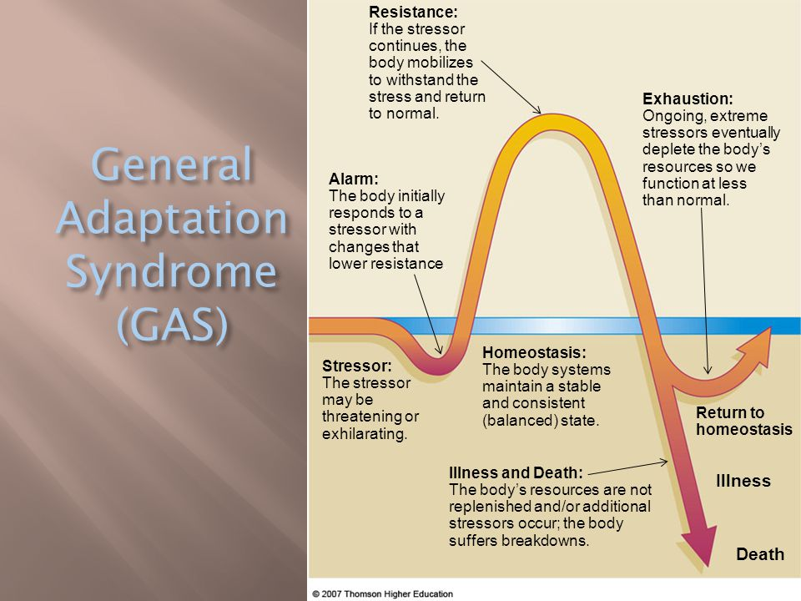
General Adaptation Syndrome - Illustration
R
U

Slide 20
General Adaptation Syndrome example
Ap
Doctor Who
Season 05 Episode 10
“Vincent and the Doctor”
(46 mins)
The Doctor and Amy travel back in time to meet Vincent Van Gogh and face an invisible monster that only the painter can see.
The
Doctor
Amy
Pond
Vincent Van Gogh

Slide 21
General Adaptation Syndrome
Ap
An
Which characters demonstrated which stages of the General Adaptation Syndrome (alarm, adaptation, and exhaustion)?
Explain.
The
Doctor
Amy
Pond
Vincent Van Gogh

Slide 22
Fight / Flight Reaction

Slide 23
Fight / Flight Reaction
R
U
“
An emotional and visceral response to an emergency that is designed to mobilize energy for attacking or avoiding the offending stimulus.
It is characterized by a pattern of physiological changes elicited by activity of the sympathetic nervous system in response to stress that leads to mobilization of energy for physical activity (e.g., attacking or avoiding the offending stimulus), either directly or by inhibiting physiological activity that does not contribute to energy mobilization.
”
VandenBos, G. R. (Ed.). (2007). APA Dictionary of Psychology. Washington, DC, US: American Psychological Association.

Slide 24
Fight / Flight Reaction
R
U
“
Specific sympathetic responses involved in the reaction include:
energy supply to smooth muscles, metabolism, and thermoregulation;
energy conservation; and increased heart rate, respiratory rate, sweat gland activity, and blood glucose level.
These are followed by regulatory response of the parasympathetic nervous system in the body’s physiological effort to control and suppress the initial responses to stress.
”
VandenBos, G. R. (Ed.). (2007). APA Dictionary of Psychology. Washington, DC, US: American Psychological Association.

Slide 25
Fight / Flight Reaction
Ap
An
Which characters demonstrated the fight/flight reaction?
Explain.
The
Doctor
Amy
Pond
Vincent Van Gogh

Slide 26
Three Categories of Stress

Slide 27
Three Categories of Stress
R
U
“
Acute - Short-term events which do not last long but if traumatic, can have a lasting impact on us.
Episodic - Situations which are also short-term but which we find ourselves in regularly, such as rushing to work or other recurring stressful experiences in the workplace.
Chronic - Ongoing stresses which last into the long-term. These may include the stress of illness or the friction of a fractious relationship.
”
VandenBos, G. R. (Ed.). (2007). APA Dictionary of Psychology. Washington, DC, US: American Psychological Association.

Slide 28
Three Categories of Stress
Ap
An
Do any of the characters experience examples of acute, episodic, and chronic stress ?
Explain.
The
Doctor
Amy
Pond
Vincent Van Gogh

Slide 29
Main Causes of Stress

Slide 30
Causes of Stress
R
U
Work Stressors
Personal Appearance
Social
Competition
Health Worries
Life Changes
Financial Worries
Relationships
Bereavement
Past Events
Source: https://www.psychologistworld.com/stress/ten-causes-of-stress-how-to-avoid-them.php#

Slide 31
Causes of Stress
Ap
An
Which of the main causes of stress affected the characters?
Explain.
The
Doctor
Amy
Pond
Vincent Van Gogh

Slide 32
Strategies to Manage Stress

Slide 33
Strategies to Manage Stress
Remove the Stressor
Withdraw from the Stressor
Change Stress Perceptions
Control Stress Consequences
Receive Social Support
Source: (McShane, 2012, p. 112-113)

Slide 34
Stress Management
Ap
An
Did the characters use any of the stress management techniques?
Were they successful?
The
Doctor
Amy
Pond
Vincent Van Gogh

Slide 35

Thank You
ebeerwart@nait.ca

